Slide 1

Data Analytics with Python
㈜라온비트 박진수

Slide 2
Data Science
개발 환경 설정
Python Basic
Data Analysis packages
ScikitLearn
Deep Learning with Python

Slide 3
Data Science

Slide 4
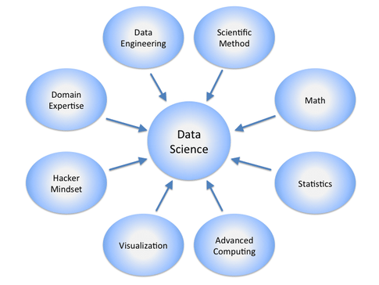
Overview

Slide 5
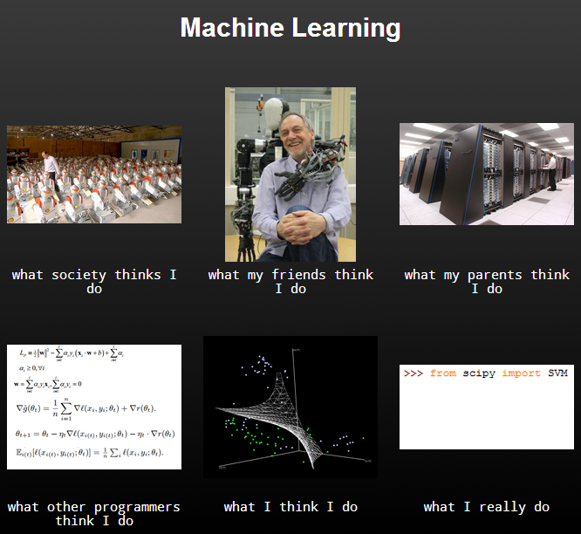
Machine Learning
http://sentdex.com/sentiment-analysisbig-data-and-python-tutorials-algorithmic-trading/machine-learning-algorithmic-trading-automated-trading/

Slide 6
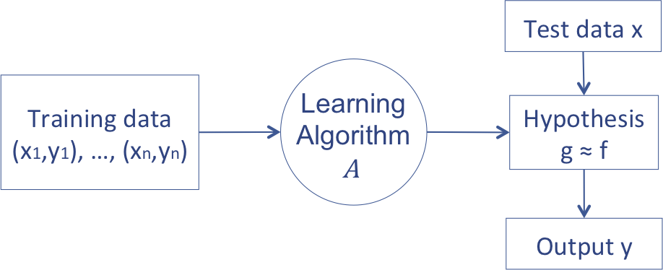
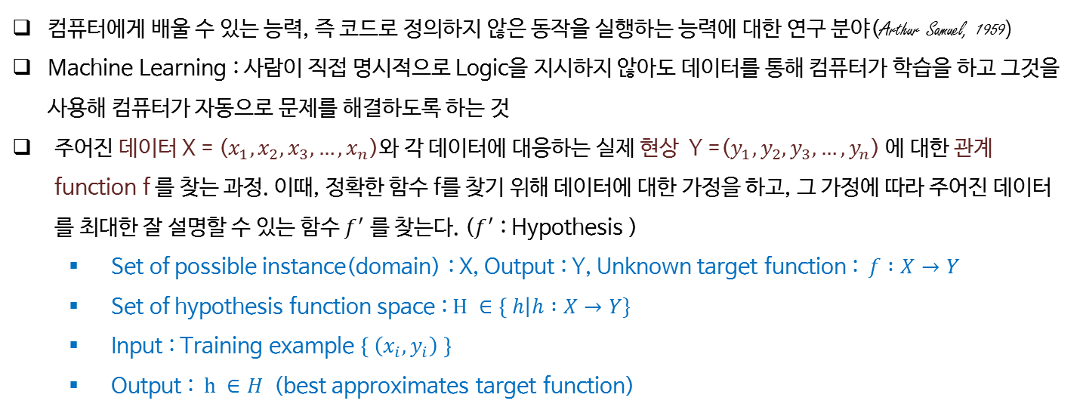
Machine Learning
컴퓨터에게 배울 수 있는 능력, 즉 코드로 정의하지 않은 동작을 실행하는 능력에 대한 연구 분야(Arthur Samuel, 1959)
Machine Learning : 사람이 직접 명시적으로 Logic을 지시하지 않아도 데이터를 통해 컴퓨터가 학습을 하고 그것을 사용해 컴퓨터가 자동으로 문제를 해결하도록 하는 것
주어진 데이터 X = ($x_{1},x_{2},x_{3}, …,x_{n}$)와 각 데이터에 대응하는 실제 현상 Y =($y_{1},y_{2},y_{3}, …,y_{n}$) 에 대한 관계 function f 를 찾는 과정. 이때, 정확한 함수 f를 찾기 위해 데이터에 대한 가정을 하고, 그 가정에 따라 주어진 데이터를 최대한 잘 설명할 수 있는 함수 $f^{′}$ 를 찾는다. ($f^{′}$ : Hypothesis )
Set of possible instance(domain) : X, Output : Y, Unknown target function : $f :X→Y$
Set of hypothesis function space : $H ∈\left\{ h\right|h :X→Y\}$
Input : Training example $\left\{ \left(x_{i},y_{i}\right) \right\}$
Output : $h ∈H$ (best approximates target function)

Slide 7
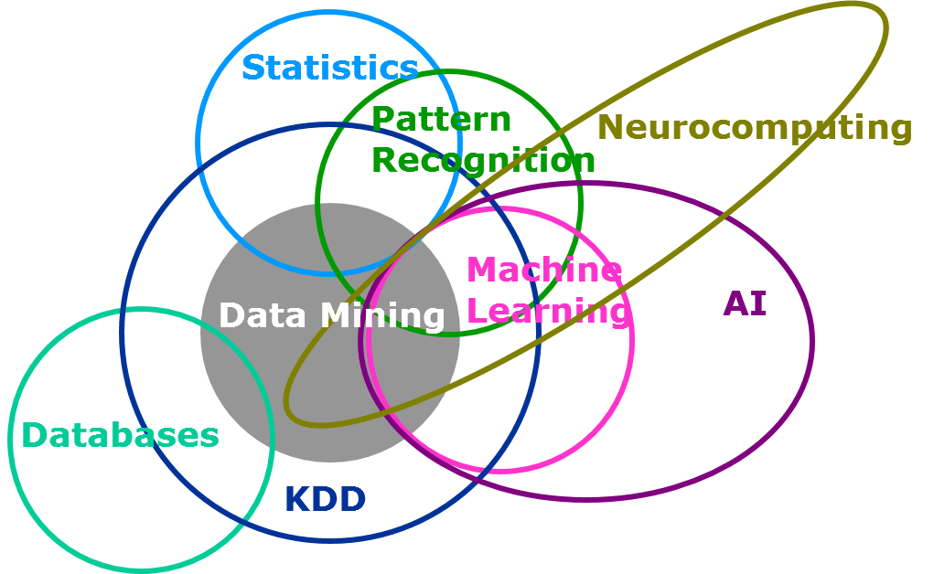
Machine Learning
Data Mining : 데이터의 미처 몰랐던 속성을 발견하는 것
Deep Learning : 여러 비선형 변환기법의 조합을 통해 높은 수준의 추상화를 시도하는 기계학습 알고리즘의 집합
그림 출처 : http://blogs.sas.com/content/subconsciousmusings/2014/08/22/looking-backwards-looking-forwards-sas-data-mining-and-machine-learning/

Slide 8
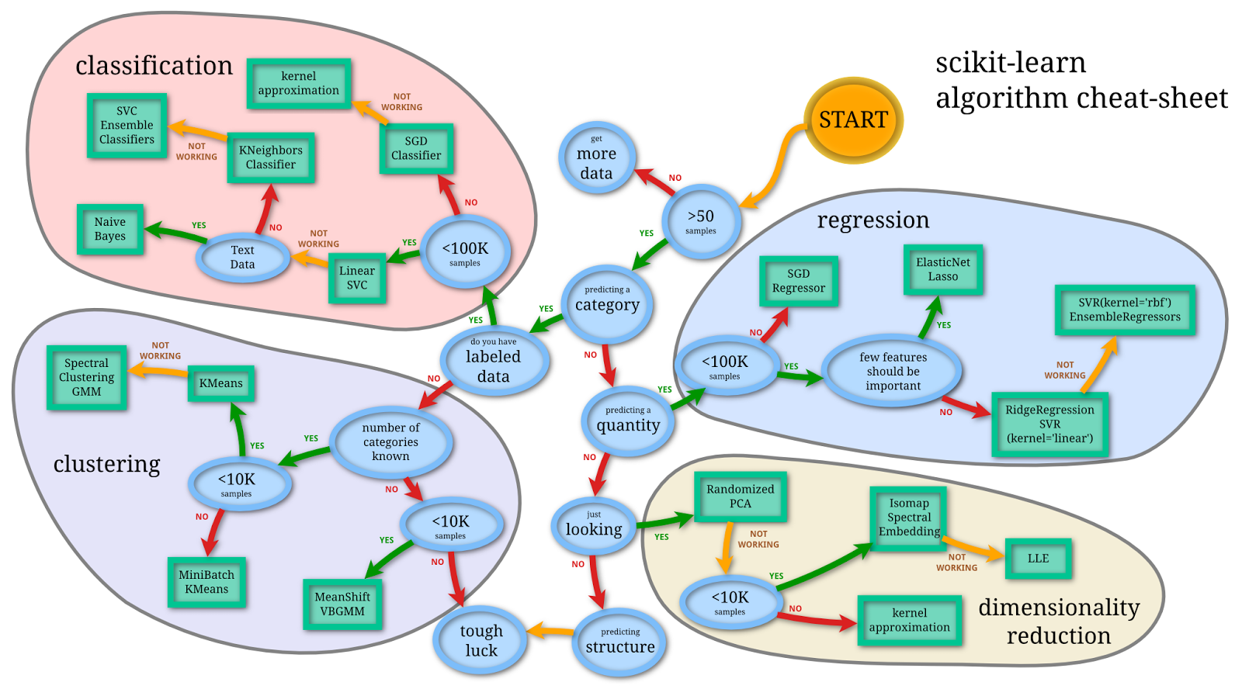
Machine Learning

Slide 9
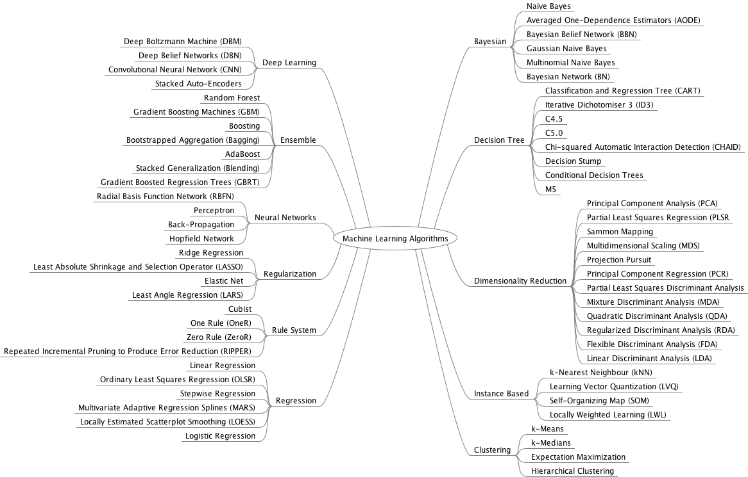
Machine Learning

Slide 10
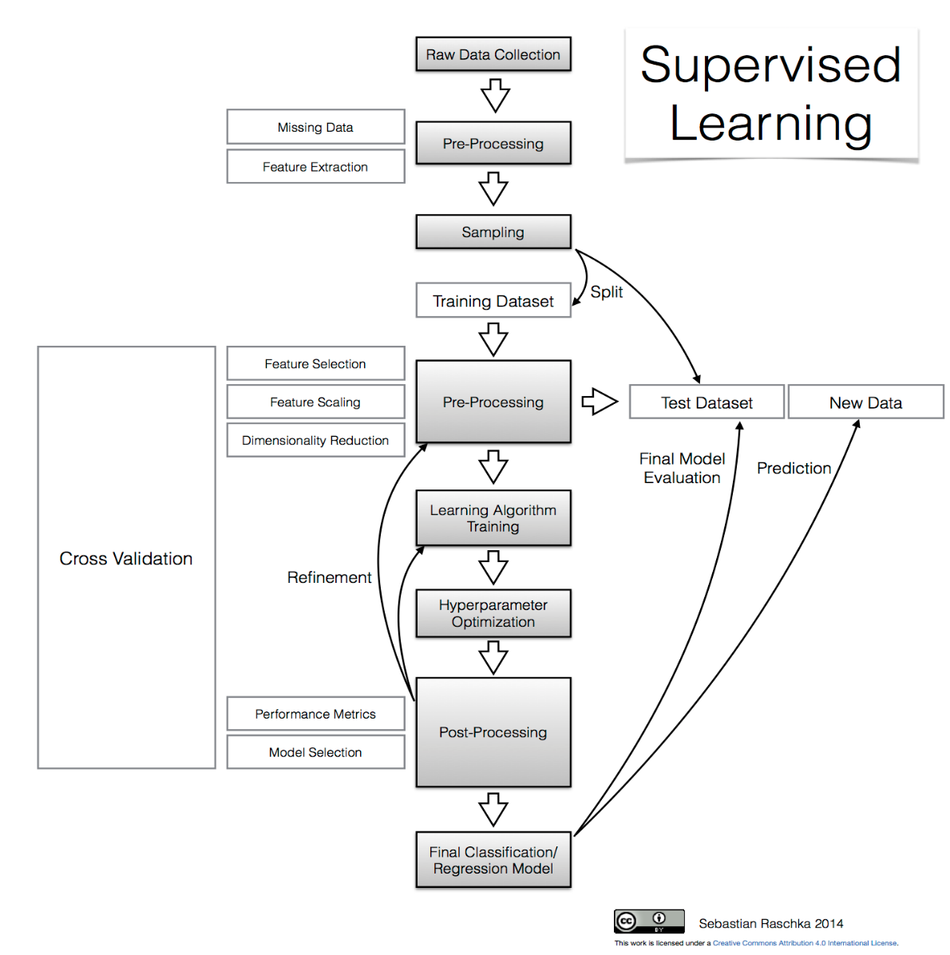
Machine Learning
http://sebastianraschka.com/Articles/2014_intro_supervised_learning.html

Slide 11
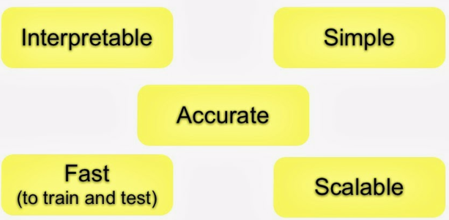
Machine Learning
question > input data > features > algorithm > parameter > evaluation

Slide 12
개발 환경 설정

Slide 13
개발 환경
Python Anaconda
https://www.continuum.io/downloads
Virtual Environment
http://docs.python-guide.org/en/latest/dev/virtualenvs/
Pycharm
https://www.jetbrains.com/pycharm/
Jupyter Notebook
http://jupyter.org/

Slide 14
Virtualenv
Virtual environment 생성
virtualenv myenv1
cd myenv1
Scripts\activate
(myenv1) D:\myenv1>
Python을 지정하여 Virtual environment 생성
virtualenv -p d:\Anaconda3\python.exe myenv2

Slide 15
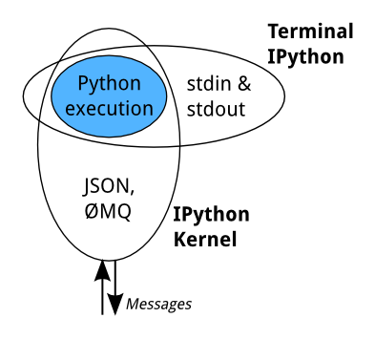
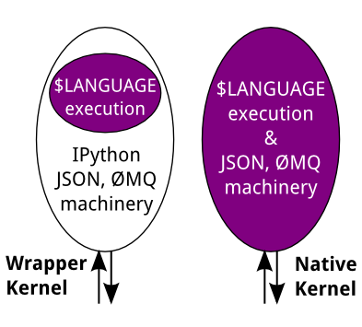
Jupyter Architecture
https://github.com/ipython/ipython/wiki/IPython-kernels-for-other-languages

Slide 16
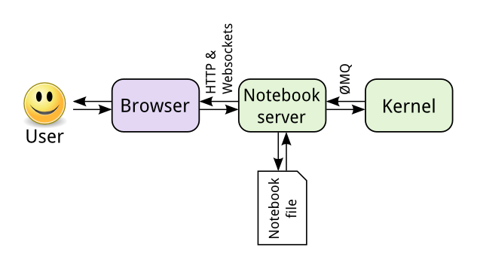
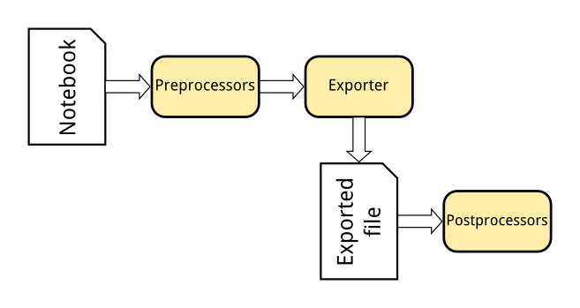
Jupyter Architecture

Slide 17
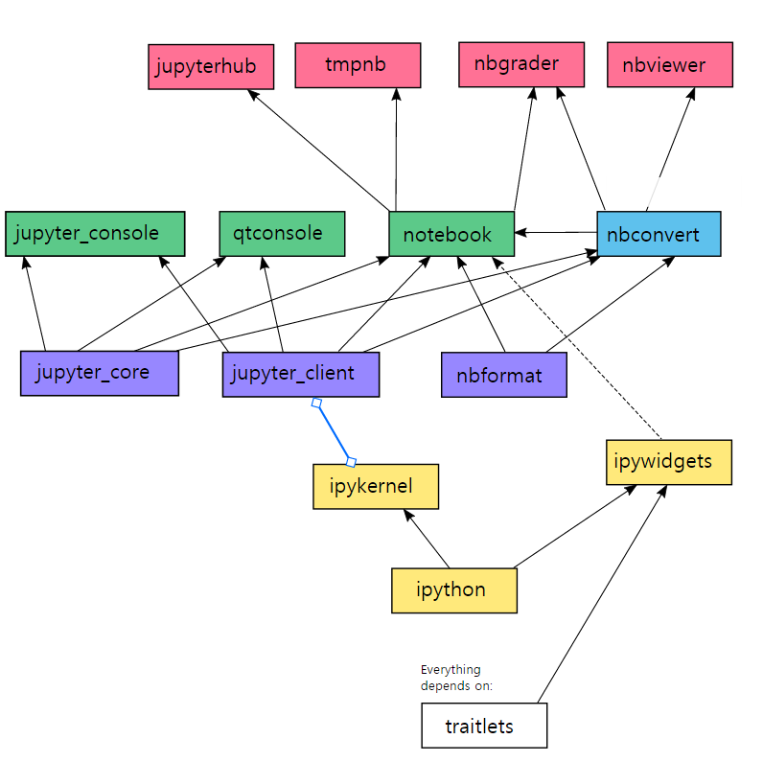
Jupyter Architecture

Slide 18
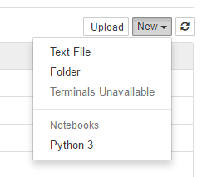
Jupyter 설정
Run jupyter
jupyter notebook
http://localhost:8888/tree#notebooks
Python 2 Kernel
conda create -n ipykernel_py2 python=2 ipykernel
activate ipykernel_py2
python -m ipykernel install --user
Virtualenv 사용
conda create -n myenv python=3.5 anaconda
activate myenv
python -m ipykernel install --user --name myenv --display-name "Python (myenv)"

Slide 19
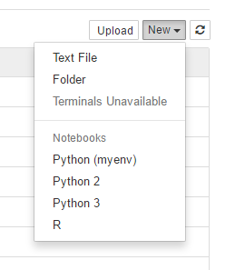
Jupyter 설정
R Kernel
R install
R console
install.packages(c('repr', 'pbdZMQ', 'devtools'))
devtools::install_github('IRkernel/IRdisplay')
devtools::install_github('IRkernel/IRkernel')
IRkernel::installspec()

Slide 20
Python Basic

Slide 21
Python 특징
High-level
Interpreted
Interactive
Object-oriented
Scripting
Imperative
Functional
Easy-to-learn
Easy-to-read
Easy-to-maintain
Python
Jython
IronPyton

Slide 22
Data Types
Number
정수 : a = 123
실수 : a = 123.45, a = 3.4e10
복소수 : a = 1 + 2j, a = -3j
8진수 : a = 0o123
16진수 : a = 0x123
연산자
**, //
Number
String
List
Tuple
Dictionary
Set
Boolean

Slide 23
Data Types
String
a = ‘hello world’
a = “hello world”
a = “”” hello
world”””
a = ‘’’hello
world’’’
코드 | 설명
%s | 문자열 (String)
%c | 문자 1개(character)
%d | 정수 (Integer)
%f | 부동소수 (floating-point)
%o | 8진수
%x | 16진수
%% | Literal % (문자 % 자체)

Slide 24
Data Types
List
a = [ ] ( a = list() )
b = [1, 2, 3]
c = ['Life', 'is', 'too', 'short']
d = [1, 2, 'Life', 'is']
e = [1, 2, ['Life', 'is']]
Tuple (immutable List)
t1 = ()
t2 = (1,)
t3 = (1, 2, 3)
t4 = 1, 2, 3
t5 = ('a', 'b', ('ab', 'cd'))

Slide 25
Data Types
Dictionary
dic = {'name':'pey', 'phone':'0119993323', 'birth': '1118'}
Set (unique & unordered list)
s1 = set([1,2,3])
s2 = set(“Hello”)

Slide 26
Data Types
Boolean
Value | True / False
"python" | True
"" | False
[1, 2, 3] | True
[] | False
() | False
{} | False
1 | True
0 | False
None | False

Slide 27
Data Types
Mutable vs. Immutable
Mutable | Immutable
list | numbers(int, float, complex)
dictionary | string
set | tuple
byte array | frozenset
 | bytes

Slide 28
Control Flow statements
if 조건문:
….수행할 문장1
….수행할 문장2
else:
….수행할 문장A
….수행할 문장B
while 조건문:
….수행할 문장1
….수행할 문장2
….수행할 문장3
for 변수 in 리스트(또는 튜플, 문자열):
….수행할 문장1
….수행할 문장2
if
while
for

Slide 29
File read/write
file = open(file name, mode)
file.close()
mode | 설명
r | read
w | write
a | append
with open(file name, mode) as f:
f.readlines()
with open(file name, mode, encoding=‘utf-8’) as f:
f.readlines()

Slide 30
Function / Class
Function
Class
def 함수명(입력 인수):
<수행할 문장1>
<수행할 문장2>
class 클래스이름(상속 클래스명):
<클래스 변수 1>
<클래스 변수 2>
...
def 클래스함수1(self[, 인수1, 인수2,,,]):
<수행할 문장 1>
<수행할 문장 2>
...
def 클래스함수2(self[, 인수1, 인수2,,,]):
<수행할 문장1>
<수행할 문장2>
...
...

Slide 31
Module / Package
Module
package
# calc.py
def plus(a, b):
return a + b
def minus(a, b):
return a - b
game/
__init__.py
sound/
__init__.py
echo.py
wav.py
graphic/
__init__.py
screen.py
render.py
play/
__init__.py
run.py
test.py
import game.soud.echo
import calc
mod1.plus(1,2)
from calc import plus, minus
from calc import *
plus(1,2)
minus(3,2)

Slide 32
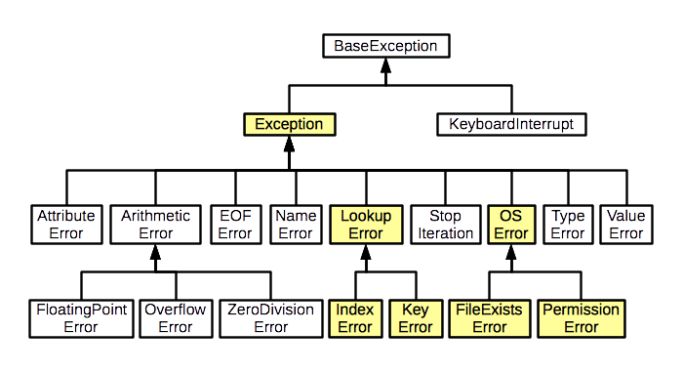
Exception Handling

Slide 33
Exception Handling
def exception_handle(path): try: f = open(path, 'r') except IOError: print('File not exist') else: print('File has ', len(f.readlines()), ' lines') f.close() finally: print('try to open file')
class OverTenException(Exception): def __init__(self,val): self.val = val def __str__(self): return 'Over ten number {}. Only allowed 1~10'.format(self.val) def readNumber(): num = int(input(' input number : ')) if(num > 10): raise OverTenException(num) print("Number : ", num)

Slide 34
Functional Programming

Slide 35
Functional Programming
Imperative Programming : mutable variables, assignments, control structure(if-then-else, loop, break, continue, return) – C++, Java
Logic Programming : formal logic – Prolog, Answer set programming(ASP)
Functional Programming
restricted sense : not use imperative programming paradigm
wider sense : use function, functions can be values that are produces, consumed, composed.
function can be defined anywhere, including side other functions
like any other value, they can be passed as parameters to functions and returned as results
as for other values, there exists a set operators to compose functions

Slide 36
Imperative vs. Functional
def imperativeFactorial(n): result = 1 for i in range(2, n+1): result = result * i return result
def declarativeFactorial(n): if n == 1: return 1 else: return n * declarativeFactorial(n-1)

Slide 37
Functional Programming
Avoid state
Immutable variable
First-class functions
Higher-order functioins
Pure functions
Recursion, tail recursion
Iterators, sequences
laze evaluation
pattern matching
monad, monoid

Slide 38
Imperative vs. Functional
“1+2+++3++4”, 0
“1”, 0
“2”, 1
“”, 3
“”, 3
“3”, 3
“”, 6
“4”, 6
10
expr, result = "1+2+++3++4", 0 for s in expr.split('+'): if s != "": result += int(s) print(result)
from operator import add from functools import * expr = "1+2+++3++4" result = reduce(add,
map(int, filter(bool, expr.split('+')))) print(result)
“1+2+++3++4”
[“1”, “2”, “”, “”, “3”, “”, “4 ]
[“1”, “2”, “3”, “4 ]
[1, 2, 3, 4 ]
10

Slide 39
Map
Map
name_lengths = map(len, ["Mary", "Isla", "Sam"]) print(list(name_lengths)) for name in ["Mary", "Isla", "Sam"]: print(len(name))
lambda
squares = map(lambda x: x * x, [0, 1, 2, 3, 4]) print(list(squares))
Excercise
import random names = ['Mary', 'Isla', 'Sam'] code_names = ['Mr. Pink', 'Mr. Orange', 'Mr. Blonde'] for i in range(len(names)): names[i] = random.choice(code_names) print(names)

Slide 40
Reduce
Reduce
sum = reduce(lambda a, x: a + x, [0, 1, 2, 3, 4]) print(sum)
sentences = ['Mary read a story to Sam and Isla.', 'Isla cuddled Sam.', 'Sam chortled.'] sam_count = reduce(lambda a, x: a + x.count('Sam'), sentences, 0)
Excercise
people = [{'name': 'Mary', 'height': 160},
{'name': 'Isla', 'height': 80}, {'name': 'Sam'}]
height_total = 0 height_count = 0 for person in people: if 'height' in person: height_total += person['height'] height_count += 1 if height_count > 0: average_height = height_total / height_count print(average_height)

Slide 41
High-ordered function
from time import time def speak(topic): print("My speach is " + topic) def timer(fn): def inner(*args, **kwargs): t = time() fn(*args, **kwargs) print("took {time}".format(time=time()-t)) return inner speaker = timer(speak) speaker("FP with Python")

Slide 42
Partial Function
def log(level, message): print("[{level}]: {msg}".format(level=level, msg=message)) def debug(message): log("debug", message) log("debug", "Start doing something") debug("Start doing something")
def log(level, message): print("[{level}]: {msg}".format(level=level, msg=message)) from functools import partial debug = partial(log, "debug") log("debug", "Start doing something") debug("Start doing something")

Slide 43
Currying function
import math def simple_sum(a, b): return sum(range(a, b+1)) def square_sum(a, b): return sum(map(lambda x: x**2, range(a,b+1))) def log_sum(a, b): return sum(map(math.log, range(a,b+1))) print(simple_sum(1,10)) print(square_sum(1,10)) print(log_sum(1,10))
def fsum(f): def apply(a, b): return sum(map(f, range(a,b+1))) return apply log_sum = fsum(math.log) square_sum = fsum(lambda x: x**2) simple_sum = fsum(lambda x:x) print(simple_sum(1,10)) print(square_sum(1,10)) print(log_sum(1,10))

Slide 44
Good functional programming
from functools import reduce
list = ['Park', 'Kim', 'Lee'] reduce(lambda sum, s: sum + len(s), list, 0) reduce(lambda a, b: a + b, map(lambda s:len(s), list)) from operator import add reduce(add, map(len, list))

Slide 45
Other functional programming language
python: map(lambda x, x*2, [1,2,3]) Scala : List(1,2,3).map(_*2)
Clojure: (map #(* % 2)’(1,2,3))
Haskell : map(2*)[1,2,3]

Slide 46
Data analysis packages

Slide 47
NumPy, SciPy, Pandas, Matplotlib
NumPy
core library for scientific computing
high-performance multidimensional array
functions for these array
SciPy
collection of mathematical algorithm
convenience functions
built on the NumPy
Pandas
fast, flexible and expressive data structures
dataframe
Matplotlib
2D plots of array

Slide 48
NumPy
Create Array
import numpy as np a = np.array([1, 2, 3]) print(type(a)) print(a.shape) print(a[0], a[1], a[2]) a[0] = 5 print(a) b = np.array([[1,2,3],[4,5,6]]) print(b.shape) print(b[0, 0], b[0, 1], b[1, 0] )
a = np.zeros((2, 2)) print(a) b = np.ones((1, 2)) print(b) c = np.full((2, 2), 7) print(c) d = np.eye(2) print(d) e = np.random.random((2, 2)) print(e)

Slide 49
NumPy
Indexing
a = np.array([[1,2,3,4], [5,6,7,8], [9,10,11,12]]) b = a[:2, 1:3] print(a) print(b) print(a[0, 1]) b[0, 0] = 77 print(a) print(b)
[[ 1 2 3 4]
[ 5 6 7 8]
[ 9 10 11 12]]
[[2 3]
[6 7]]
2
[[ 1 77 3 4]
[ 5 6 7 8]
[ 9 10 11 12]]
[[77 3]
[ 6 7]]
Notes:
notebook

Slide 50
NumPy
Data type
Data type | Description
bool_ | Boolean (True or False) stored as a byte
int_ | Default integer type (same as C long; normally either int64 or int32)
intc | Identical to C int (normally int32 or int64)
intp | Integer used for indexing (same as C ssize_t; normally either int32 or int64)
int8 | Byte (-128 to 127)
int16 | Integer (-32768 to 32767)
int32 | Integer (-2147483648 to 2147483647)
int64 | Integer (-9223372036854775808 to 9223372036854775807)
uint8 | Unsigned integer (0 to 255)
uint16 | Unsigned integer (0 to 65535)
uint32 | Unsigned integer (0 to 4294967295)
uint64 | Unsigned integer (0 to 18446744073709551615)
float_ | Shorthand for float64.
float16 | Half precision float: sign bit, 5 bits exponent, 10 bits mantissa
float32 | Single precision float: sign bit, 8 bits exponent, 23 bits mantissa
float64 | Double precision float: sign bit, 11 bits exponent, 52 bits mantissa
complex_ | Shorthand for complex128.
complex64 | Complex number, represented by two 32-bit floats (real and imaginary components)
complex128 | Complex number, represented by two 64-bit floats (real and imaginary components)
Notes:
notebook

Slide 51
NumPy
Broadcasting
x = np.array([[1,2,3], [4,5,6], [7,8,9], [10, 11, 12]]) v = np.array([1, 0, 1]) y = x + v print(y)
[[ 2 2 4]
[ 5 5 7]
[ 8 8 10]
[11 11 13]]
Notes:
모양이 다른 array에 대한 연산

Slide 52
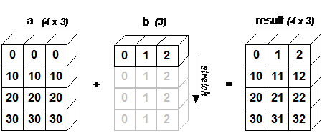
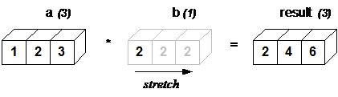
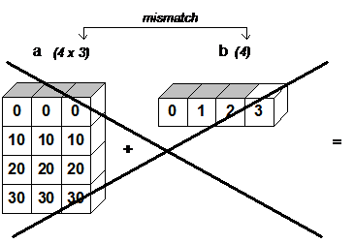
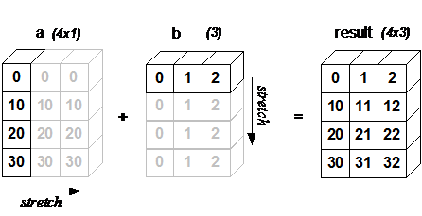
NumPy
Broadcasting
Notes:
모양이 다른 array에 대한 연산

Slide 53
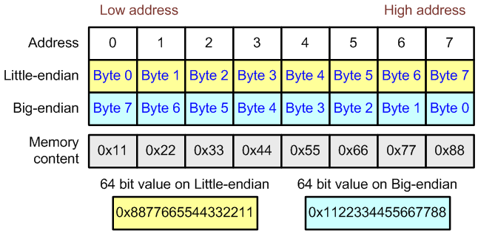
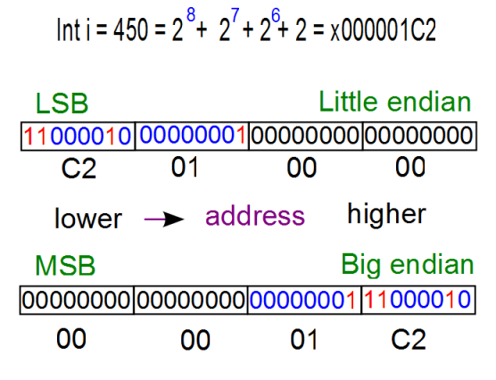
NumPy
Byte-swapping
Notes:
모양이 다른 array에 대한 연산

Slide 54
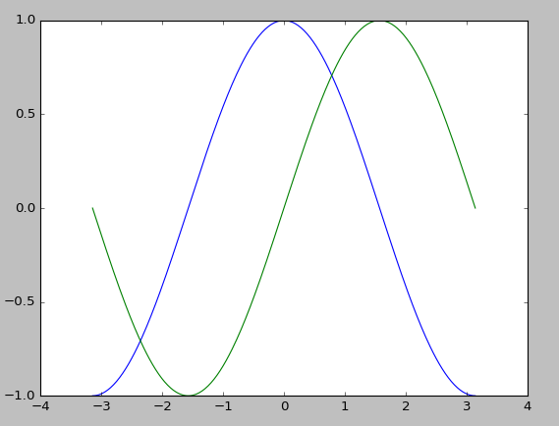
Matplotlib
2D-graphics
Jupyter notebook : %matplotlib inline
from matplotlib import pyplot as plt
import numpy as np import matplotlib.pyplot as plt X = np.linspace(-np.pi, np.pi, 256, endpoint=True) C, S = np.cos(X), np.sin(X) plt.plot(X, C) plt.plot(X, S) plt.show()
Notes:
모양이 다른 array에 대한 연산

Slide 55
SciPy
collection of mathematical algorithms and convenience functions built on the Numpy extension of Python
Subpackage | Description
cluster | Clustering algorithms
constants | Physical and mathematical constants
fftpack | Fast Fourier Transform routines
integrate | Integration and ordinary differential equation solvers
interpolate | Interpolation and smoothing splines
io | Input and Output
linalg | Linear algebra
ndimage | N-dimensional image processing
odr | Orthogonal distance regression
optimize | Optimization and root-finding routines
signal | Signal processing
sparse | Sparse matrices and associated routines
spatial | Spatial data structures and algorithms
special | Special functions
stats | Statistical distributions and functions
weave | C/C++ integration
Notes:
모양이 다른 array에 대한 연산

Slide 56
Pandas
high-performance, easy-to-use data structures and data analysis tools
R | pandas
dim(df) | df.shape
head(df) | df.head()
slice(df, 1:10) | df.iloc[:9]
filter(df, col1 == 1, col2 == 1) | df.query('col1 == 1 & col2 == 1')
df[df$col1 == 1 & df$col2 == 1,] | df[(df.col1 == 1) & (df.col2 == 1)]
select(df, col1, col2) | df[['col1', 'col2']]
select(df, col1:col3) | df.loc[:, 'col1':'col3']
select(df, -(col1:col3)) | df.drop(cols_to_drop, axis=1)
distinct(select(df, col1)) | df[['col1']].drop_duplicates()
distinct(select(df, col1, col2)) | df[['col1', 'col2']].drop_duplicates()
sample_n(df, 10) | df.sample(n=10)
sample_frac(df, 0.01) | df.sample(frac=0.01)
Notes:
모양이 다른 array에 대한 연산

Slide 57
데이터 분석 실습

Slide 58
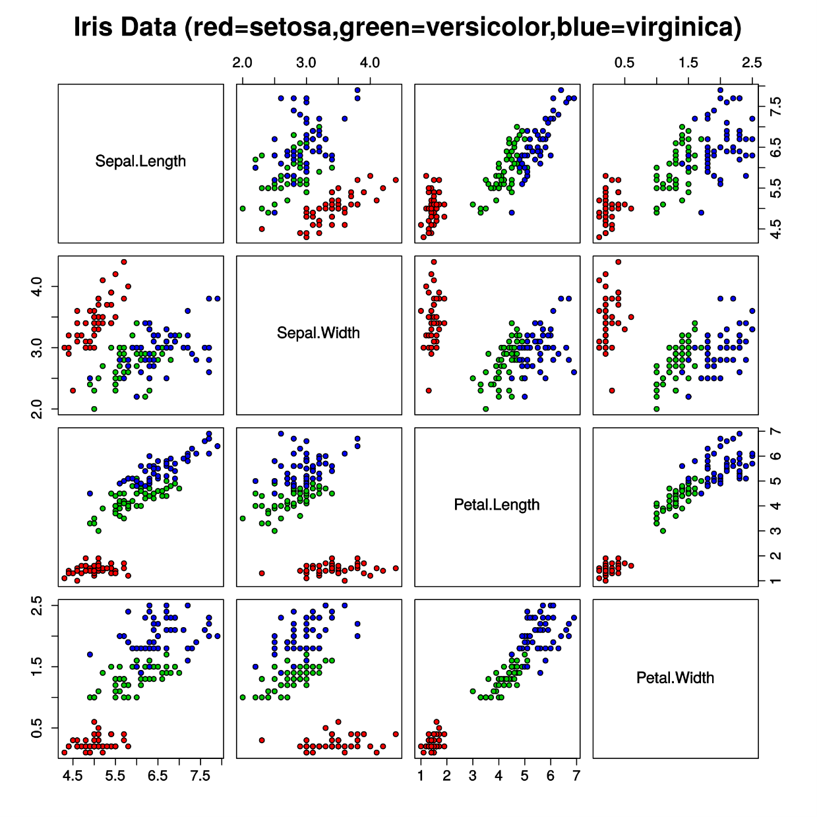
IRIS classification
Notes:
모양이 다른 array에 대한 연산

Slide 59
Deep Learning with Tensorflow

Slide 60
TensorFlow 설치
VGA 확인 : lspci | grep VGA, lspci | grep NVIDIA
Install CUDA toolkit
NVIDIA compute capability >= 3.0 : https://developer.nvidia.com/cuda-gpus
https://developer.nvidia.com/cuda-downloads
Install cuDNN (v4)
https://developer.nvidia.com/cudnn
cp cudnn-7.0-linux-x64-v4.0-prod.tgz /usr/local
cd /usr/local
tar xvzf cudnn-7.0-linux-x64-v4.0-prod.tgz
sudo chmod a+r /usr/local/cuda/include/cudnn.h /usr/local/cuda/lib64/libcudnn*
Notes:
모양이 다른 array에 대한 연산

Slide 61
TensorFlow 설치
Anaconda에 conda env 생성
conda create -n tensorflow python=3.5
source activate tensorflow
Install TensorFlow
pip3 install --upgrade $TF_BINARY_URL
prepending /srv/data1/anaconda3/envs/tensorflow/bin to PATH
(tensorflow) iwannab1@dev1:~$
# Ubuntu/Linux 64-bit, CPU only, Python 3.5
(tensorflow)$ export TF_BINARY_URL=https://storage.googleapis.com/tensorflow/linux/cpu/tensorflow-0.9.0-cp35-cp35m-linux_x86_64.whl
# Ubuntu/Linux 64-bit, GPU enabled, Python 3.5
# Requires CUDA toolkit 7.5 and CuDNN v4. For other versions, see "Install from sources" below.
(tensorflow)$ export TF_BINARY_URL=https://storage.googleapis.com/tensorflow/linux/gpu/tensorflow-0.9.0-cp35-cp35m-linux_x86_64.whl
Notes:
모양이 다른 array에 대한 연산

Slide 62
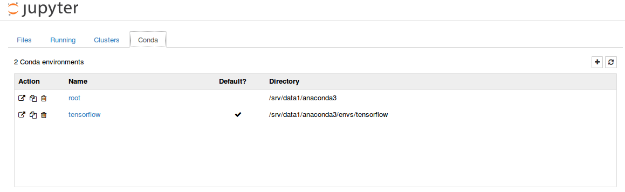
TensorFlow 설치
환경 설정
export LD_LIBRARY_PATH="$LD_LIBRARY_PATH:/usr/local/cuda/lib64"
export CUDA_HOME=/usr/local/cuda
설치 확인
source activate tensorflow
(tensorflow) iwannab1@dev1:/srv/data1/training$ jupyter notebook
Notes:
모양이 다른 array에 대한 연산

Slide 63
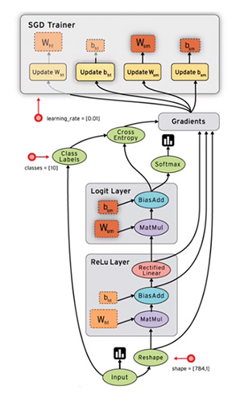
TensorFlow
Notes:
모양이 다른 array에 대한 연산

Slide 64
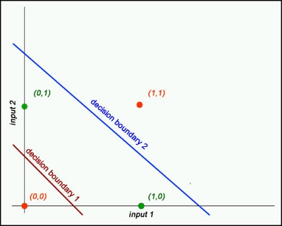
XOR

Slide 65
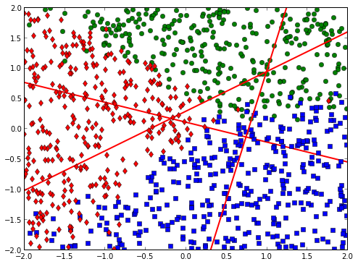
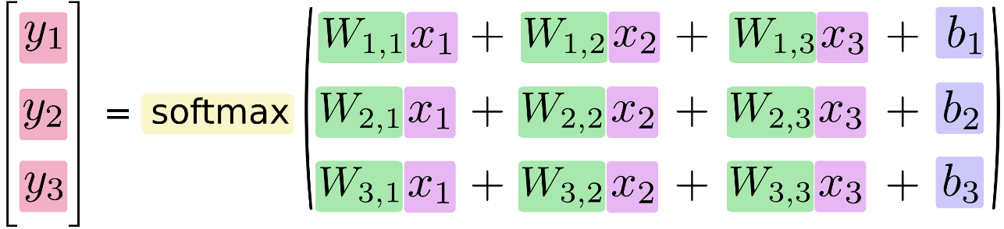
Softmax Regression
Notes:
모양이 다른 array에 대한 연산

Slide 66
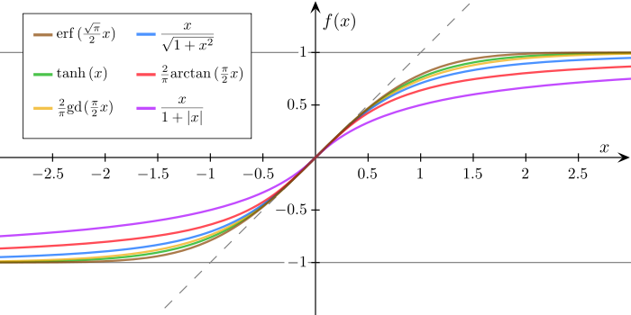
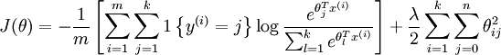
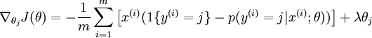
Softmax Regression
Sigmoid Function
Cost Function
Gradients Function
Notes:
모양이 다른 array에 대한 연산

Slide 67

Softmax Regression
https://www.tensorflow.org/versions/r0.9/tutorials/mnist/download/index.html

Slide 68
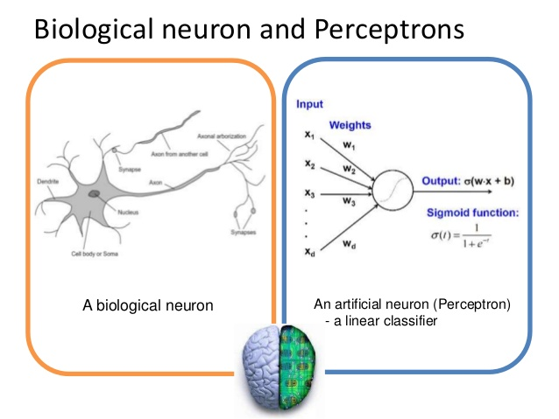
Neural Network
Notes:
모양이 다른 array에 대한 연산

Slide 69
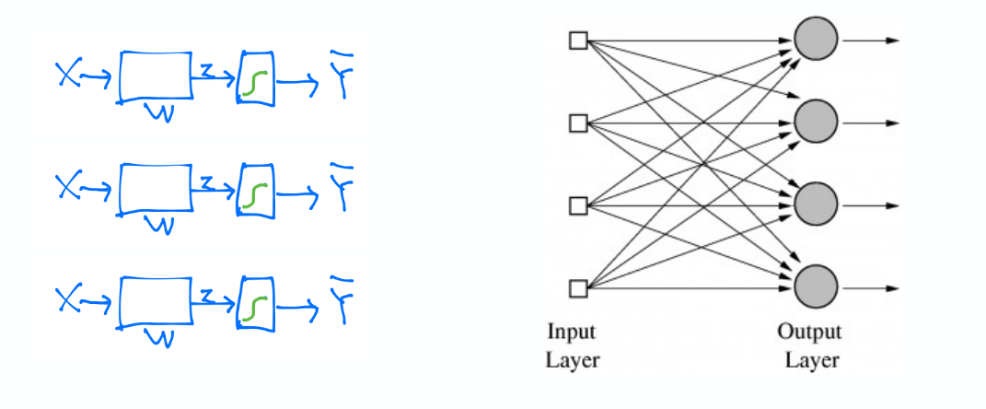
Neural Network
http://www.andreykurenkov.com/writing/a-brief-history-of-neural-nets-and-deep-learning/
Notes:
모양이 다른 array에 대한 연산

Slide 70

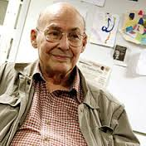
Multi Layer perceptron
Weight, bias 값을 학습시킬 방법 없음
Marvin Minsky

Slide 71
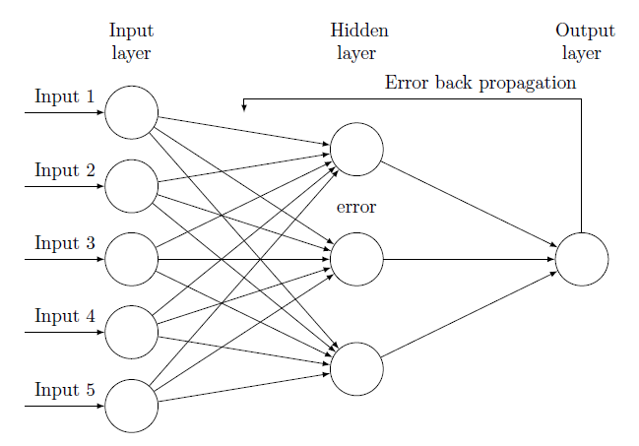

Backpropagation
Vanishing gradient
Geoffrey Hinton

Slide 72
propargation
f = w*x + b, g = w*x, f = g + b
W
*
g()
X
+
f()
b

Slide 73
forward propargation
f = w*x + b, g = w*x, f = g + b
w = -2, x = 5, b = 3
W= -2
*
g() = -10
X = 5
+
f() = -7
b = 3

Slide 74
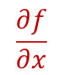
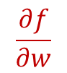
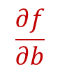
backward propargation
f = w*x + b, g = w*x, f = g + b
w = -2, x = 5, b = 3
$$\frac{∂f}{∂w}$$
W= -2
*
$$\frac{∂f}{∂x}$$
g() = -10
X = 5
error
+
f() = -7
$$\frac{∂f}{∂b}$$
b = 3

Slide 75
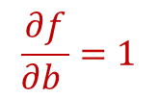
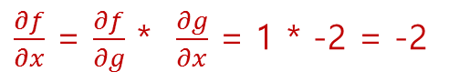
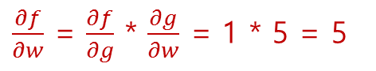
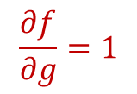
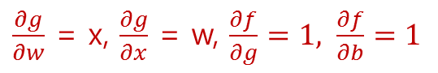
backward propargation
f = w*x + b, g = w*x, f = g + b
$\frac{∂g}{∂w}$ = x, $\frac{∂g}{∂x}$ = w, $\frac{∂f}{∂g}=1, \frac{∂f}{∂b}=1$
$\frac{∂f}{∂w}$ = $\frac{∂f}{∂g}$ * $\frac{∂g}{∂w}$ = 1 * 5 = 5
W= -2
*
g() = -10
X = 5
$$\frac{∂f}{∂g}=1$$
error
$\frac{∂f}{∂x}$ = $\frac{∂f}{∂g}$ * $\frac{∂g}{∂x}$ = 1 * -2 = -2
+
f() = -7
$$\frac{∂f}{∂b }=1$$
b = 3

Slide 76
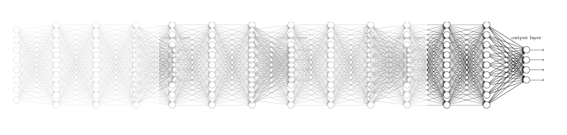
Vanishing gradient problem

Slide 77
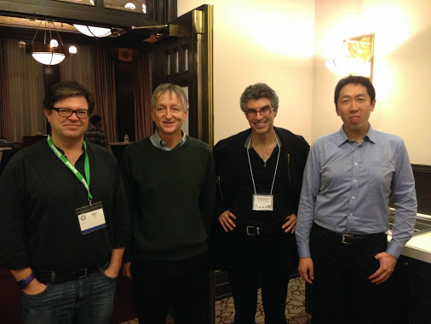
Deep learning
A fast learning algorithm for deep belief nets, 2006, Hinton
Greedy Layer-wise training of deep networks, 2007, Bengio
초기 Weight값 선정
복잡한 문제에 더 적합
LeCun, Hinton, Bengio, Ng

Slide 78
XOR
X1 | X2 | Y1 | Y2 | Y’ | XOR
0 | 0 |  |  |  | 0
0 | 1 |  |  |  | 1
1 | 0 |  |  |  | 1
0 | 1 |  |  |  | 0
Output layer
Y’ = sigmoid(W3*Y1 +
W3*Y2 + b3)
Input layer
X1
X2
Hidden layer
Y1 = sigmoid(W1*X1 + W1*X2+ b1)
Y2 = sigmoid(W2*X1 + W2*X2 + b2)

Slide 79
Vanishing gradient problem

Slide 80
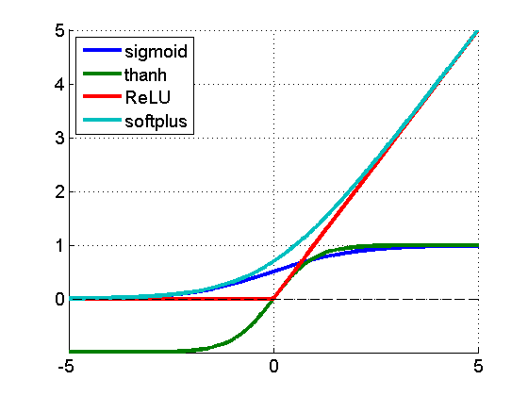
Activation Functions
tf.nn.relu(features, name=None)
tf.nn.relu6(features, name=None)
tf.nn.elu(features, name=None)
tf.nn.softplus(features, name=None)
tf.nn.softsign(features, name=None)
tf.nn.dropout(x, keep_prob, noise_shape=None, seed=None, name=None)
tf.nn.bias_add(value, bias, data_format=None, name=None)
tf.sigmoid(x, name=None)
tf.tanh(x, name=None)

Slide 81
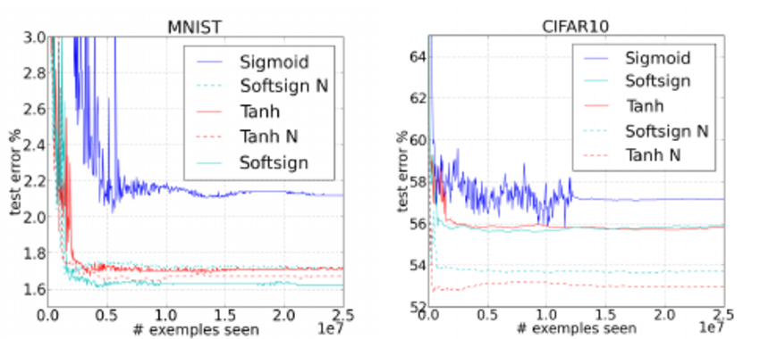
Activation Functions

Slide 82
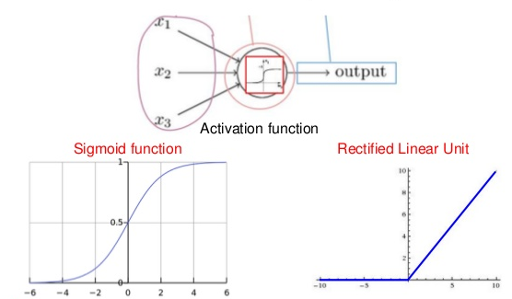
Rectified Linear Unit(ReLU)

Slide 83
Smart Weight Initializer
Xavier Initionalizer
2010 : w = np.random.randn(#in, #out) / np.sqrt(#in)
2015 : w = np.random.randn(#in, #out) / np.sqrt(#in/2)
tf.contrib.layers.xavier_initializer(uniform=True, seed=None, dtype=tf.float32)
tf.contrib.layers.xavier_initializer_conv2d(uniform=True, seed=None,
dtype=tf.float32)
tf.contrib.layers.variance_scaling_initializer(factor=2.0, mode=FAN_IN,
uniform=False, seed=None, dtype=tf.float32)
http://arxiv.org/pdf/1511.06422.pdf

Slide 84


Overfitting problem

Slide 85


Regulaization
$$f\left(w\right)≔ λR\left(w\right)+ \frac{1}{n}\sum_{i=1}^{n}{L(w; x_{i }{, y}_{i )} }$$
$x_{i } ϵ R^{d } :training data$ , $y_{i } ϵ \left( 1 ≦i ≦n\right) :corresponding labels($얻으려 하는 값)
$f\left(w\right)$ : Machine Learning formulation, 최적화 함수
L(w;.) : loss function, training data에서 모델의 오류를 측정, Cost function
R(w) : regularizer, 모델의 복잡도를 조정
$λ$ : fixed regulation parameter, 0보다 큰 값으로 손실(training error)의 감소와 모델 복잡도 감소 사이의 균형을 맞춤
L2 Regulaizer = 0.001 * tf.reduce_sum(tf.square(W))
tf.contrib.layers.apply_regularization(regularizer, weights_list=None)
tf.contrib.layers.l1_regularizer(scale)
tf.contrib.layers.l2_regularizer(scale)
tf.contrib.layers.sum_regularizer(regularizer_list)

Slide 86

Dropout

Slide 87
Dropout
dropout_rate= tf.placeholder(“float”)
L1 = tf.nn.relu(tf.matmul(X, W1), B1))
L2 = tf.nn.dropout(L1, dropout_rate)
sess.run(optimizer, feed_dict={X:x_training, Y:y_training, dropout_rate: 0.7})
accurary.eval({X:x_test, Y:y_test, dropout_rate: 1})

Slide 88


Optimizer
http://sebastianruder.com/optimizing-gradient-descent/

Slide 89
Optimizer
class tf.train.GradientDescentOptimizer
class tf.train.AdadeltaOptimizer
class tf.train.AdagradOptimizer
class tf.train.MomentumOptimizer
class tf.train.AdamOptimizer
class tf.train.FtrlOptimizer
class tf.train.RMSPropOptimizer

Slide 90

CNN(Convolutional Neural Network)

Slide 91

CNN(Convolutional Neural Network)
http://cs231n.github.io/convolutional-networks/
http://cs231n.stanford.edu/

Slide 92

CNN(Convolutional Neural Network)
Convoutional Layer
F
(N-F) / stride + 1
N
Stride

Slide 93

CNN(Convolutional Neural Network)
Pooling Layer(Max Pooling)

Slide 94

CNN(Convolutional Neural Network)
Fully Connected Layer
http://cs.stanford.edu/people/karpathy/convnetjs/demo/cifar10.html

Slide 95


CNN(Convolutional Neural Network)
LaNet ( LeCun, 1998)
AlexNet ( Krizhevsky, 2012)

Slide 96

CNN(Convolutional Neural Network)
Google LeNet ( Google, 2014)
http://www.ieiespc.org/include/pdfdownload.asp?filename=IEEKSPC_2015_4_1_20150316181059_1.pdf

Slide 97

CNN(Convolutional Neural Network)
Example

Slide 98


CNN(Convolutional Neural Network)
Convolutional Layer
1st Convolution Layer
32 filters(3 x 3 x 1)
Stride : 1
padding : SAME(VALID)
28
28 x 28 x 1
32
28
W1 = tf.Variable(tf.random_normal([3,3,1,32], stddev=0.01))
_la1 = tf.nn.conv2d(X, W1, strides=[1,1,1,1], padding=‘SAME’)
la1 = tf.nn.relu(_la1)
28
28

Slide 99
CNN(Convolutional Neural Network)
Padding : Same
out_height = ceil(float(in_height) / float(strides[1]))
out_width = ceil(float(in_width) / float(strides[2]))
pad_along_height = ((out_height - 1) * strides[1] + filter_height - in_height)
pad_along_width = ((out_width - 1) * strides[2] +filter_width - in_width)
pad_top = pad_along_height / 2
pad_left = pad_along_width / 2
Padding : Valid
out_height = ceil(float(in_height - filter_height + 1) / float(strides[1]))
out_width = ceil(float(in_width - filter_width + 1) / float(strides[2]))

Slide 100

CNN(Convolutional Neural Network)
Pooling Layer
2
2
14 * 14 * 32
p1 = tf.nn.max_pool(la1, ksize=[1,2,2,1], stride=[1,2,2,1], padding=‘SAME’)

Slide 101
CNN(Convolutional Neural Network)
subsampling - Dropout
14 * 14 * 32
p1 = tf.nn.dropout(p1, 0.5)

Slide 102
CNN(Convolutional Neural Network)
Fully Connected Layer
W4 = tf.Variable(tf.random_normal([4*4*128, 625], stddev=0.01))
W5 = tf.Variable(tf.random_normal([625, 10], stddev=0.01))
la4 = tf.nn.relu(tf.matmul(l3, w4))
la4 = tf.nn.dropout(l4, 0.5)
H = tf.matmul(la4, W5)

Slide 103
RNN(Recurrent Neural Network)
Language Modeling
Speech Recognition
Machine Translation
Conversation Modeling/Question Answering
Image/Video Captioning
Image/Music/Dance Generation
Notes:
GRU, LSTM

Slide 104


RNN(Recurrent Neural Network)

Slide 105

RNN(Recurrent Neural Network)
http://colah.github.io/posts/2015-08-Understanding-LSTMs/
Notes:
GRU, LSTM

Slide 106

RNN(Recurrent Neural Network)
Long-Term dependencies problem
나는 프랑스에서 자랐습니다. 나는 유창한 프랑스어를 구사합니다.
Notes:
GRU, LSTM

Slide 107



LSTM(Long Short Term Memory)
RNN
LSTM

Slide 108
LSTM(Long Short Term Memory)
RNN
LSTM

Slide 109


LSTM(Long Short Term Memory)
cell state
linear conveyor belt
add information by gate
remove information by gate

Slide 110


LSTM(Long Short Term Memory)
Forget gate layer : 이전 상태와 입력값을 보고어떤 정보를 버릴지 결정
input gate layer : 어떤 값들을 갱신할 지 결정
tanh layer : cell state에 더해딜 수 있는 새로운 후보 값들의 벡터 생성

Slide 111

LSTM(Long Short Term Memory)
상태 갱신 : Ct-1 을 Ct로 갱신

Slide 112

LSTM(Long Short Term Memory)
Sigmoid layer : 출력 결정

Slide 113
Natural Language Processing(NLP)
NLP
Computer Science
Artificial Intelligence
Linguistics

Slide 114

Data representation
Discrete atomic symbols

Slide 115
Distributional Hypothesis
You shall know a word by the company it keeps (J. R, Firth)
같은 contex에 있는 단어는 같은 semantic meanin을 공유한다는 가정
count based method
단어, 문맥 출현 횟수를 세는 방법
SVD(LSA), HAL
predictive method
단어에서 문맥 또는 문맥에서 단어를 예측하는 방법
word2vec, NPLM

Slide 116

Language Data Representation (Word embeddings)
One-Hot encoding
Vector representation
Word | representaion
man | 100000
woman | 010000
uncle | 001000
ant | 000100
king | 000010
queen | 000001
Word | representaion
man | 0.06 -0.01 0.13 0.07 0.04 0.05
woman | 0.07 0.01 -0.13 0.07 -0.04 0.05
uncle | 0.08 -0.01 0.13 0.07 0.04 0.05
ant | 0.09 -0.01 0.13 0.07 0.06 0.05
king | 0.03 -0.01 0.13 0.07 0.07 0.05
queen | 0.01 0.02 0.13 0.07 0.09 -0.05
http://w.elnn.kr/search/

Slide 117


Word2Vec
Vector representation
Sweden 유사어
각 단어를 200차원 정도의 공간 벡터로 표현
기존 방법(NNLM, RNNLM 등)에 비해서 계산량을 엄청나게 줄임, 빠름
Efficient Estimation of Word Representaions in Vector Space

Slide 118

Word2Vec

Slide 119

Word2Vec
CBOW(Continous Bag-Of-Words)
주어진 단어에 대해 앞 뒤로 C/2개 씩 총 C개의 단어를 input 으로 사용하여 주어진 단어를 예측
input, projection, output layer
input layer에서는 들어오는 단어를 one-hot encoding
각 단어를 각각 projection 시킨후 그 벡터의 평균을 구해서 projection layer로 보냄
projection layer에 weight matri를 곱해서 output layer로 보낸후 softmax
이 결과를 진짜 단어의 one-hot encoding 과 비교
모든 단어들이 공통적으로 사용하는 VxN 크기의 projection matrix W
NxV 크기의 weight Matrix W’
http://blog.naver.com/jangbalam99/10029491008
Notes:
The first proposed architecture is similar to the feedforward NNLM, where the non-linear hidden layer is removed and the projection layer is shared for all words (not just the projection matrix); thus, all words get projected into the same position (their vectors are averaged)

Slide 120

Word2Vec
Skip-gram
현재 주어진 단어 하나를 가지고 주위에 등장하는 나머지 단어들을 예측
예측하는 단어들의 경우 현재 단어 주위에서 샘플링
가까이 위치해 있는 단어일 수록 현재 단어와 관련이 많은 단어라는 가정
현재 대부분 skip-gram 모델 사용
Notes:
The first proposed architecture is similar to the feedforward NNLM, where the non-linear hidden layer is removed and the projection layer is shared for all words (not just the projection matrix); thus, all words get projected into the same position (their vectors are averaged)

Slide 121


Word2Vec
Complexity reduction - Hierachical softmax
각 단어들을 leaves로 가지는 binary tree 생성
해당 단어의 확률을 계산할 때 root에서 해당 leaf로 가는 path에 따라 확률을 곱해 나가면서 확률 계산

Slide 122
Word2Vec
Complexity reduction - Negative Sampling
전체 단어에 대한 softmax 계산을 하는 대신 일부만 뽑아서 계산을 하고 normalization
positive sample : 실제 target으로 사용하는 단어
negative sample

Slide 123
Tensorflow resources in GitHub
https://github.com/aymericdamien/TensorFlow-Examples
https://github.com/sjchoi86/Tensorflow-101
https://github.com/tensorflow/tensorflow/tree/r0.10/tensorflow/models/image/cifar10

Slide 124
Contact
대표번호 | 070-4116-2876
FAX | 070-8838-2876
E-Mail | jinsu.park@raonbit.com
Homepage | http://www.raonbit.com

